Slide 1

CAR PRICE PREDICTION PROJECT

Slide 2
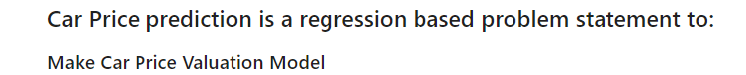
Problem Statement

Slide 3
Understanding Of Problem Statement
With the covid 19 impact in the market, we have seen lot of changes in the car market. Now some cars are in demand hence making them costly and some are not in demand hence cheaper. One of our clients works with small traders, who sell used cars. With the change in market due to covid 19 impact, our client is facing problems with their previous car price valuation machine learning models. So, they are looking for new machine learning models from new data. We have to make car price valuation model.

Slide 4
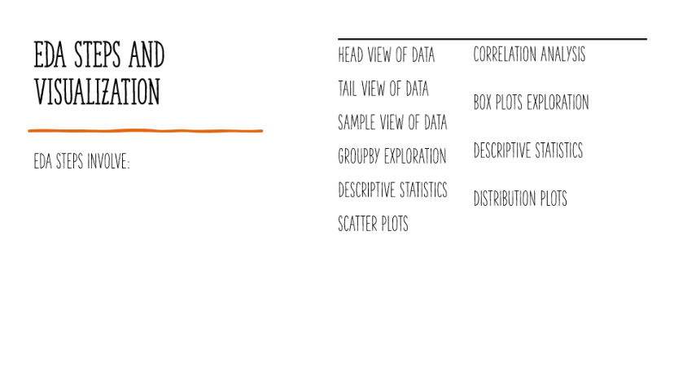

Slide 5

Visualizations Dashboard

Slide 6
Dataset View Analysis
Follow the link to the dashboard
https://docs.google.com/spreadsheets/d/1ICG7P-lWXkZFW6PpOjMSu5ZsqYHJsgdOP-FHAC7V3IE/edit?usp=sharing

Slide 7
Categorical Plots Analysis
Follow the link to the dashboard:
https://docs.google.com/spreadsheets/d/1O9pG3a0bnJanHIvkMeijokVPdsS9oa9ECDEdrYGur5s/edit?usp=sharing

Slide 8
Scatter Plots Analysis
Follow the link to the dashboard:
https://docs.google.com/spreadsheets/d/1dxkFwBEMFj4V-ue8K0Ry8M_hiNnTpYjlLBfMWfjV9Lk/edit?usp=sharing

Slide 9
Correlation Analysis
Follow the link to the dashboard:
https://docs.google.com/spreadsheets/d/1En1uQfUc-krCrQrEpF9RqyRwcIfMW6gTGkDb9GY0ye4/edit?usp=sharing

Slide 10
Box Plots Analysis
Follow the link to the dashboard:
https://docs.google.com/spreadsheets/d/1U6Z-WzSb_l_zOj1wYy4OiNmuDcMTJ0COgD8NthjtWcM/edit?usp=sharing

Slide 11
Descriptive Plots Analysis
Follow the link to the dashboard:
https://docs.google.com/spreadsheets/d/1xNxEGWUglN7ABJl0plvmK3AH_ee53idqxHIJRngWgyw/edit?usp=sharing

Slide 12
Distribution Plots Analysis
Follow the links to the dashboard:
https://docs.google.com/spreadsheets/d/1jubSGc7DWYaIOcUcfDdkVEozdyvTyIf6WgU9t-Zy4_0/edit?usp=sharing

Slide 13
EDA Conclusion
Based On EDA done above in two parts, I will do ftest and pvalue test on these seemingly weak indicators based primarily on skewness, kurtosis and multicollinearity:
Year Of Purchase Pct Change (Multicollinearity & Kurtosis)
Most of the biased features have strong explanatory power in terms of correlation with feature, skewness or kurtosis and hence can be filtered in ensemble method of feature selection by p value and constant variance threshold.

Slide 14
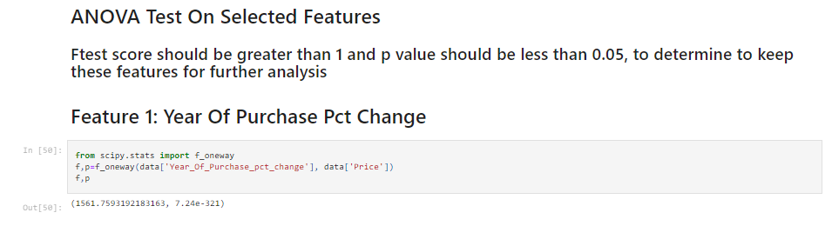
EDA Conclusion (Contd.)

Slide 15

EDA Conclusion (Contd.)
Error Removal And Data Handling
Based on above analysis:
1. There are many outliers in the data.
2. Strong multicolliearity features are important for prediction because there f test and p value are acceptable. This means that the amount of multicollineaity is insignificant and removing the feature will impact the model much.
3. Extereme leptokurtic and right skewed features are also relatively significant based on f test and p test.
Hence, as a solution, feature scaling will do a better job in explaining the dependent variable than removing whole columns.

Slide 16
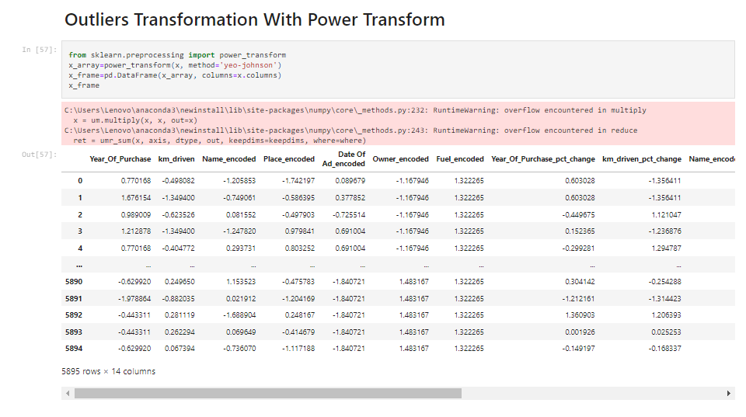
Outliers Transformation

Slide 17
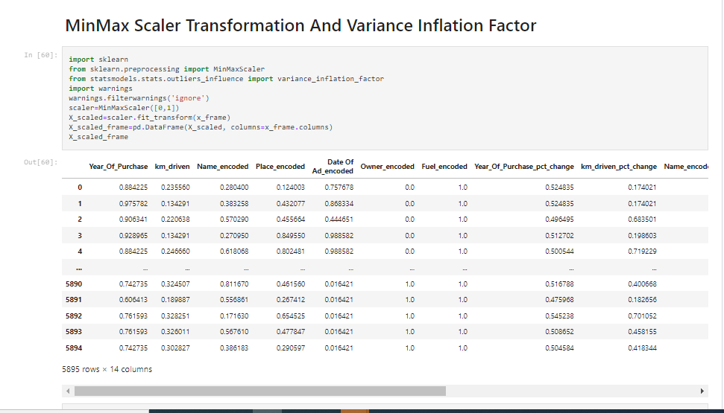
Min Max Scaling

Slide 18
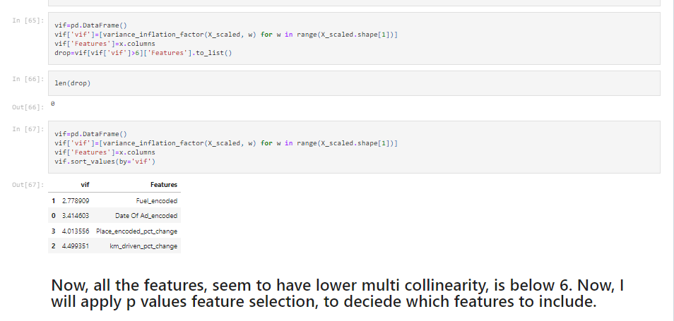
VIF Test

Slide 19
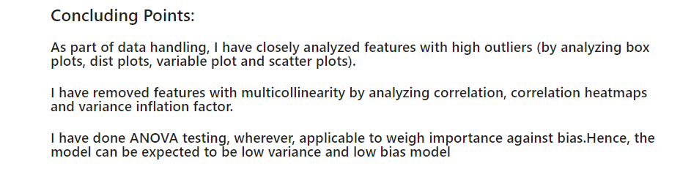
Data Handling Conclusion

Slide 20
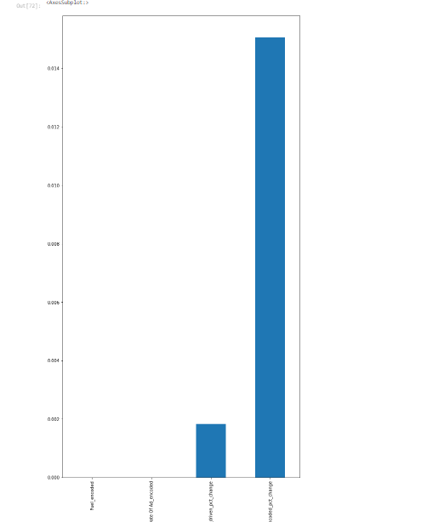

Slide 21

Steps Used To Complete The Project
Data Extraction
Data Cleaning
Feature Engineering:
Encoded Features
Extracted Features
EDA
VIF Test
Power Transform

Slide 22
Steps Used To Complete The Project (Contd.)
Data Pre Processing
Power Transform
Min Max Scaling
Vectorization
Train Test Split
Feature Selection (Ensemble Method)
Model Development, Evaluation And Selection

Slide 23
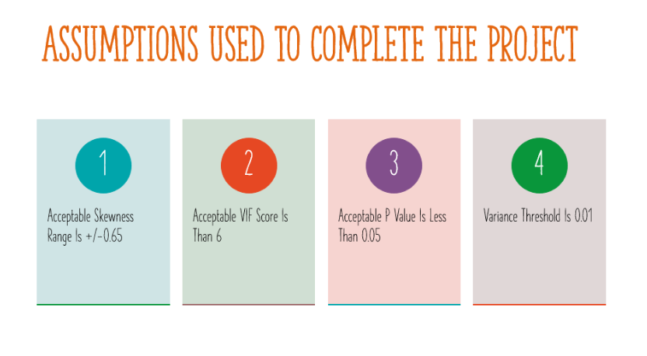

Slide 24
Models Dashboard
Follow the link to the dashboard:
https://docs.google.com/spreadsheets/d/1XcZbjH6G9gHMIyHY5mwnpnsUL27qi6XZJ-a1AbjkIGc/edit?usp=sharing

Slide 25
Conclusion
As a conclusion, Model 7: Ada Boost Regressor With Huber Regressor As Base Estimator is the best model. Its train and test scores are close to one another, hence, depicting good fit.
Evaluation Scores Of Best Model:
mse_train 707624876818.6891
rmse_train 841204.4203513728
mse_test 857728323633.2772
rmse_test 926136.2338410463

Slide 26
Thank You

